Slide 1
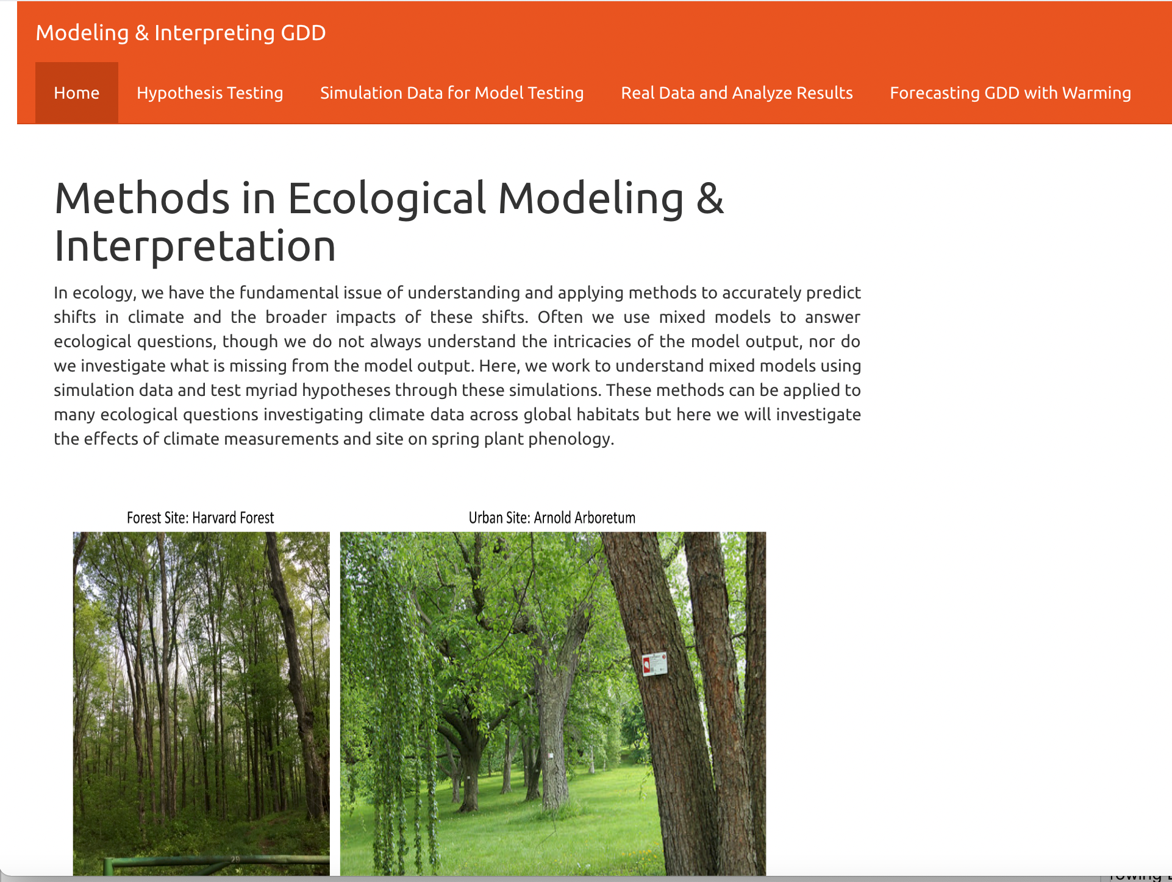
Microclimates

Slide 2
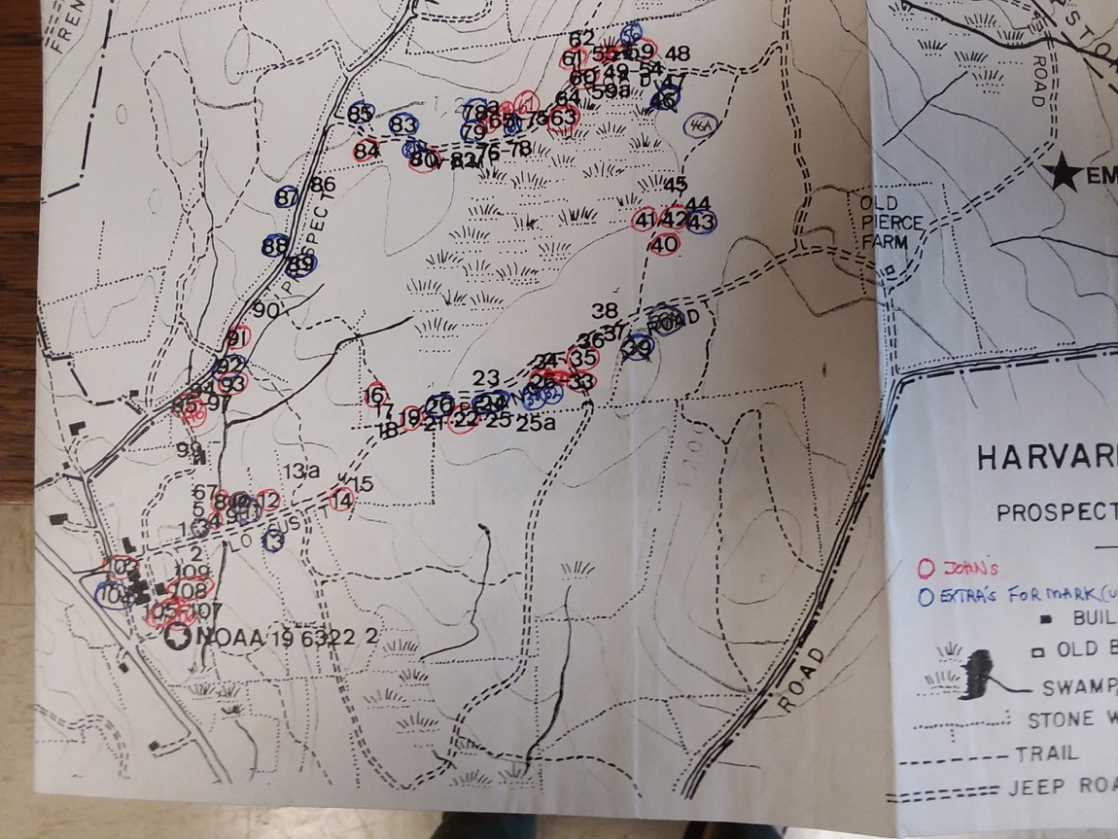
Two sites...

Slide 3
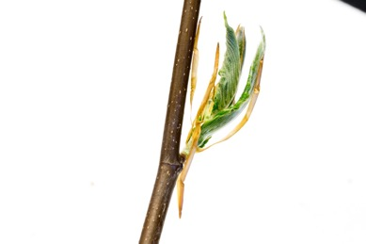
SITE EFFECT
Arboretum
Fagus grandifolia
Harvard Forest
Jan 1
Dec 31

Slide 4
Two different Methods...
Hobo Logger
Weather Station

Slide 5
METHOD EFFECT
Hobo Logger
Fagus grandifolia
Weather Station
Jan 1
Dec 31

Slide 6
Go to Jam session...

Slide 7
Noisy Weather Station Data

Slide 8
Noisy Hobo Logger Data

Slide 9
Oh goodness...
Weather Station noisy simulation
Hobo logger noisy simulation

Slide 10
Let’s check out the “raw” data and see if that clears things up...

